Slide 1


System of Linear Equations

Slide 2

System of Linear Equations
$$\begin{matrix}a_{1}x+b_{1}y+c_{1}z=d_{1} \\ a_{2}x+b_{2}y+c_{2}z=d_{2} \\ a_{3}x+b_{3}y+c_{3}z=d_{3}\end{matrix}$$
$$\left[\begin{matrix}a_{1} & a_{2} & a_{3} \\ b_{1} & b_{2} & b_{3} \\ c_{1} & c_{2} & c_{3}\end{matrix}\right]\left[\begin{matrix}x \\ y \\ z\end{matrix}\right]=\left[\begin{matrix}d_{1} \\ d_{2} \\ d_{3}\end{matrix}\right]$$
AX=B
Where A is 3*3 matrix, and B are 3*1 column matrices.

Slide 5
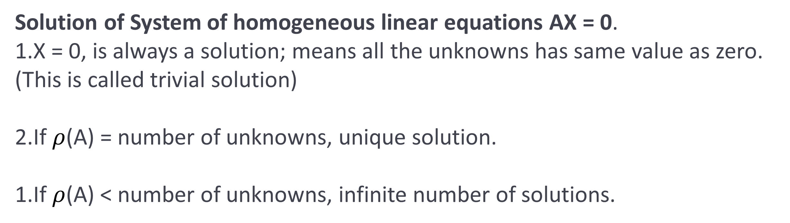

Slide 6
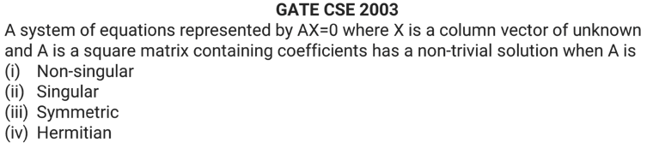

Slide 7
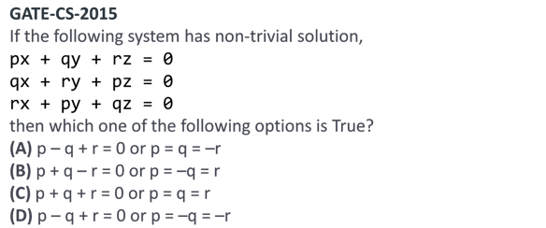

Slide 9
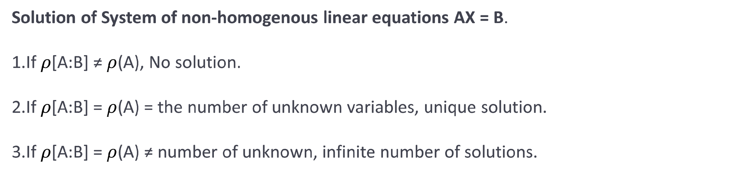

Slide 10
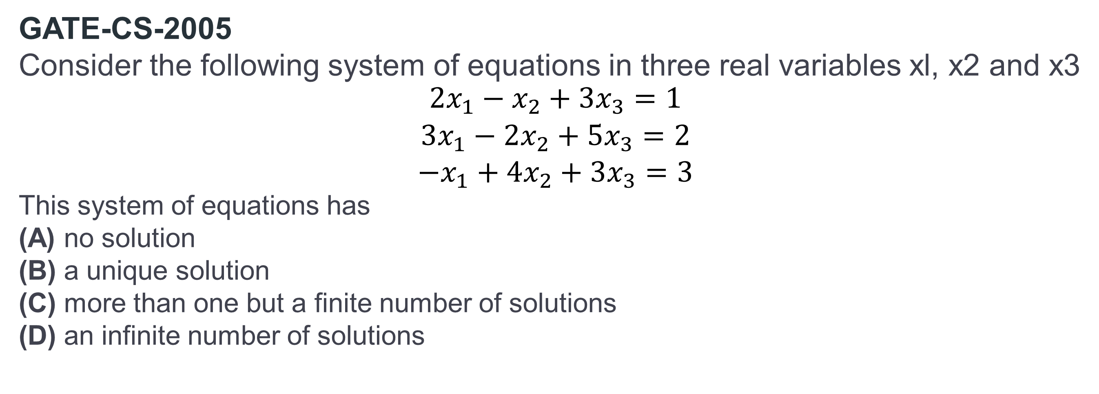
GATE-CS-2005
Consider the following system of equations in three real variables xl, x2 and x3 $$\begin{matrix}2x_{1}−x_{2}+3x_{3}=1 \\ 3x_{1}−2x_{2}+5x_{3}=2 \\ −x_{1}+4x_{2}+3x_{3}=3\end{matrix}$$
This system of equations has
(A) no solution (B) a unique solution (C) more than one but a finite number of solutions (D) an infinite number of solutions

Slide 11
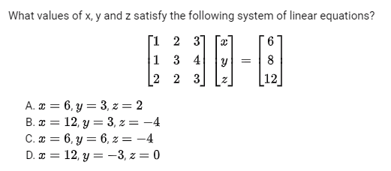
GATE IT 2004

Slide 12
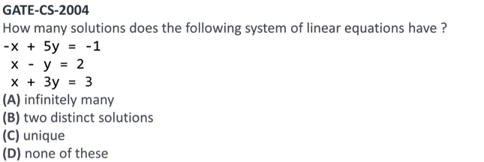

Slide 13
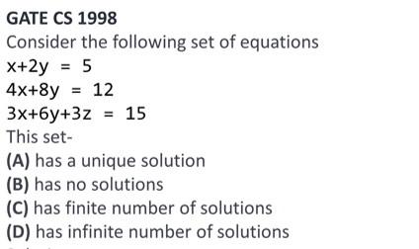

Slide 14
GATE-CS-2016 (Set 2)
Consider the systems, each consisting of m linear equations in n variables.
If m < n, then all such systems have a solution
If m > n, then none of these systems has a solution
If m = n, then there exists a system which has a solution
Which one of the following is CORRECT? (A) I, II and III are true (B) Only II and III are true (C) Only III is true (D) None of them is true

Slide 15
GATE CSE 2021
Suppose that P is a 4×5 matrix such that every solution of the equation Px=0 is a scalar multiple of [ 2 5 4 3 1 ]^{T}. The rank of P is __________

Slide 16
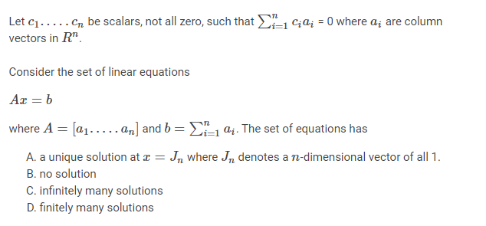
GATE CSE 2017
Answer: (C)

Slide 17
GATE CSE 2014
Consider the following system of equations:
3x+2y=1
4x+7y=1
x+y+z=3
x−2y+7z=0
The number of solutions for this system is ______________
Answer: 1

Slide 18
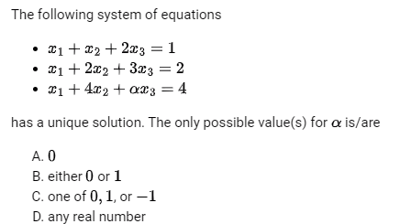
GATE CSE 2008

Slide 19
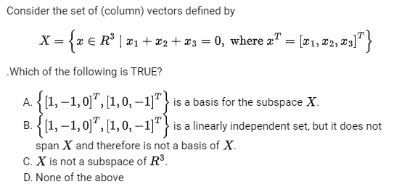
GATE CSE 2007

Slide 20
Linear Algebra
LU decomposition of a matrix is the factorization of a given square matrix into two triangular matrices, one upper triangular matrix and one lower triangular matrix, such that the product of these two matrices gives the original matrix.

Slide 21
Find the LU decomposition of the matrix,
$$\left[\begin{matrix}2 & 1 \\ 8 & 7\end{matrix}\right]$$

Slide 22


Slide 24


Slide 26
GATE-CS-2015 (Set 1)
In the LU decomposition of the matrix
$$\left[\begin{matrix}2 & 2 \\ 4 & 9\end{matrix}\right]$$
if the diagonal elements of U are both 1, then the lower diagonal entry l₂₂ of L is (A) 4 (B) 5 (C) 6 (D) 7

Slide 27
In the LU decomposition of the matrix,
$$\left[\begin{matrix}1 & 2 \\ 3 & 8\end{matrix}\right]$$
if the diagonal elements of U are both 1, then the trace of L is?

Slide 28


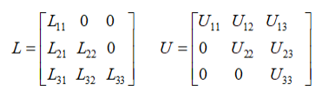
GATE CS 2022
Consider solving the following system of simultaneous equations using LU decomposition
Which one of the following is the correct combination of values for
Where L and U are denoted as

Slide 29
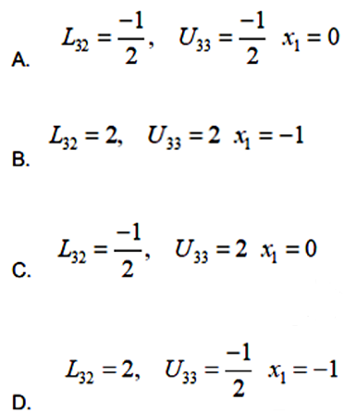

Slide 30
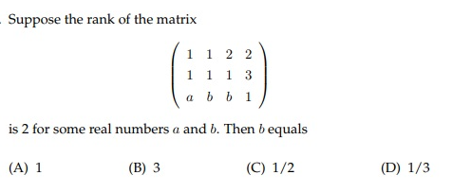

Slide 31

Thank you

